Slide 1
Technical drawings
A guide to making useful technical drawings (Engineering drawings)

Slide 2
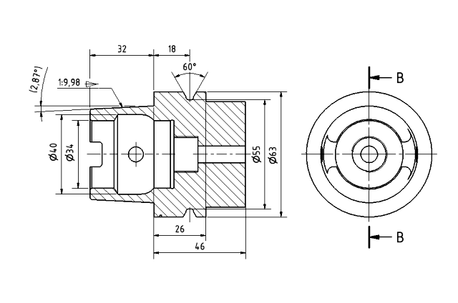
What are technical drawings?
Drawings that visually communicate how something functions or is constructed
We’ll be doing detail drawings, which specify the geometry needed to make a component
Hopefully by the end of this lesson you can read this one :D
Notes:
elaborate a bit on communication aspect

Slide 3
Lets now talk about the different types of projections!
Projections are how we transfer what we see in our 3 dimensional world into an accurate drawing on 2d paper.
In engineering, we generally use 2 types of projections when making our technical drawings. Orthographic and isometric.

Slide 4
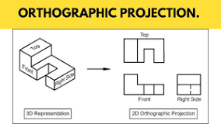
Isometric 3d drawings
Isometric 3d projections are a method to visually represent 3d objects on a 2d surface.
Take a look at the isometric 3d drawing below (Totally not taken from the internet), you can see that a 3d plane is used to give us a view of the object
Giac thinks this is easy and you don't need to worry about it lol

Slide 5
Orthographic projections
An orthographic projections (also known as a multiview) are projections where we take the views of multiple sides of objects
Typically, we take a top view (plan view), side (usually right) and front view when using these projections
Take a look at the example of this sort of projection being used (totally not taken from the internet again) to get an idea of what it looks like
We will be focusing on orthographic sketching more than isometric

Slide 6
Let's talk tools!
Depending on the scale and size of the measurement, we use different tools.
The most common tool we use to take measurements are VERNIER CALIPERS.
They offer a great level of accuracy and are versatile
We'll be working mainly with this

Slide 7
How to read a vernier caliper?

Slide 8
Some important things to note when making mechanical drawings
All measurements are in mm for what we will be designing, this is because it gives us greater precision and we will generally be designing smaller objects so it does tend to work better for us.
We aim for accuracy up to .05
Always remember to fill out the title block first
ALL DIMENSIONS ARE IN MM UNLESS OTHERWISE SPECIFIED
LINEAR TOLERANCE ±0.1
ANGULAR TOLERANCE ±0.5°
TITLE
CREATED BY
DRAWING NO.
MATERIAL
PLA (POLYLACTIC ACID)
CHECKED BY
SCALE

Slide 9
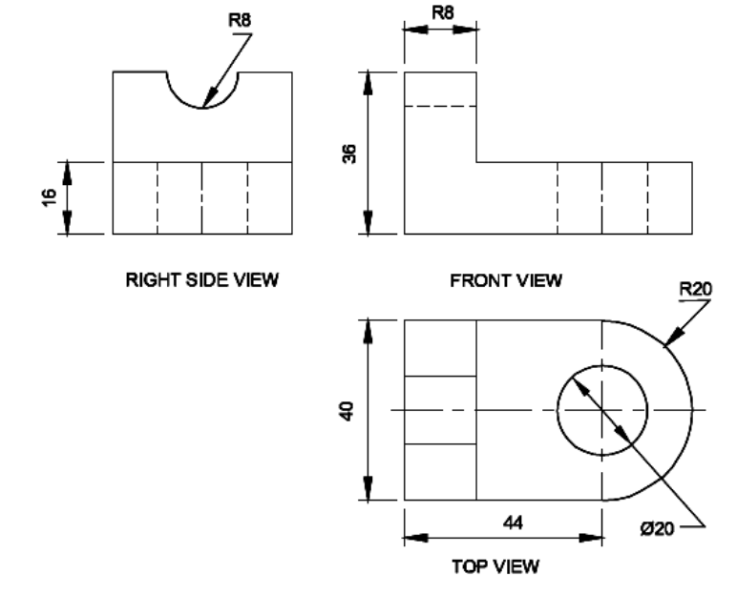
16

Slide 10
AND THAT’S A WRAP!, ANY QUESTIONS?
Now try drawing the different 3d printed models in front of you

